Slide 1
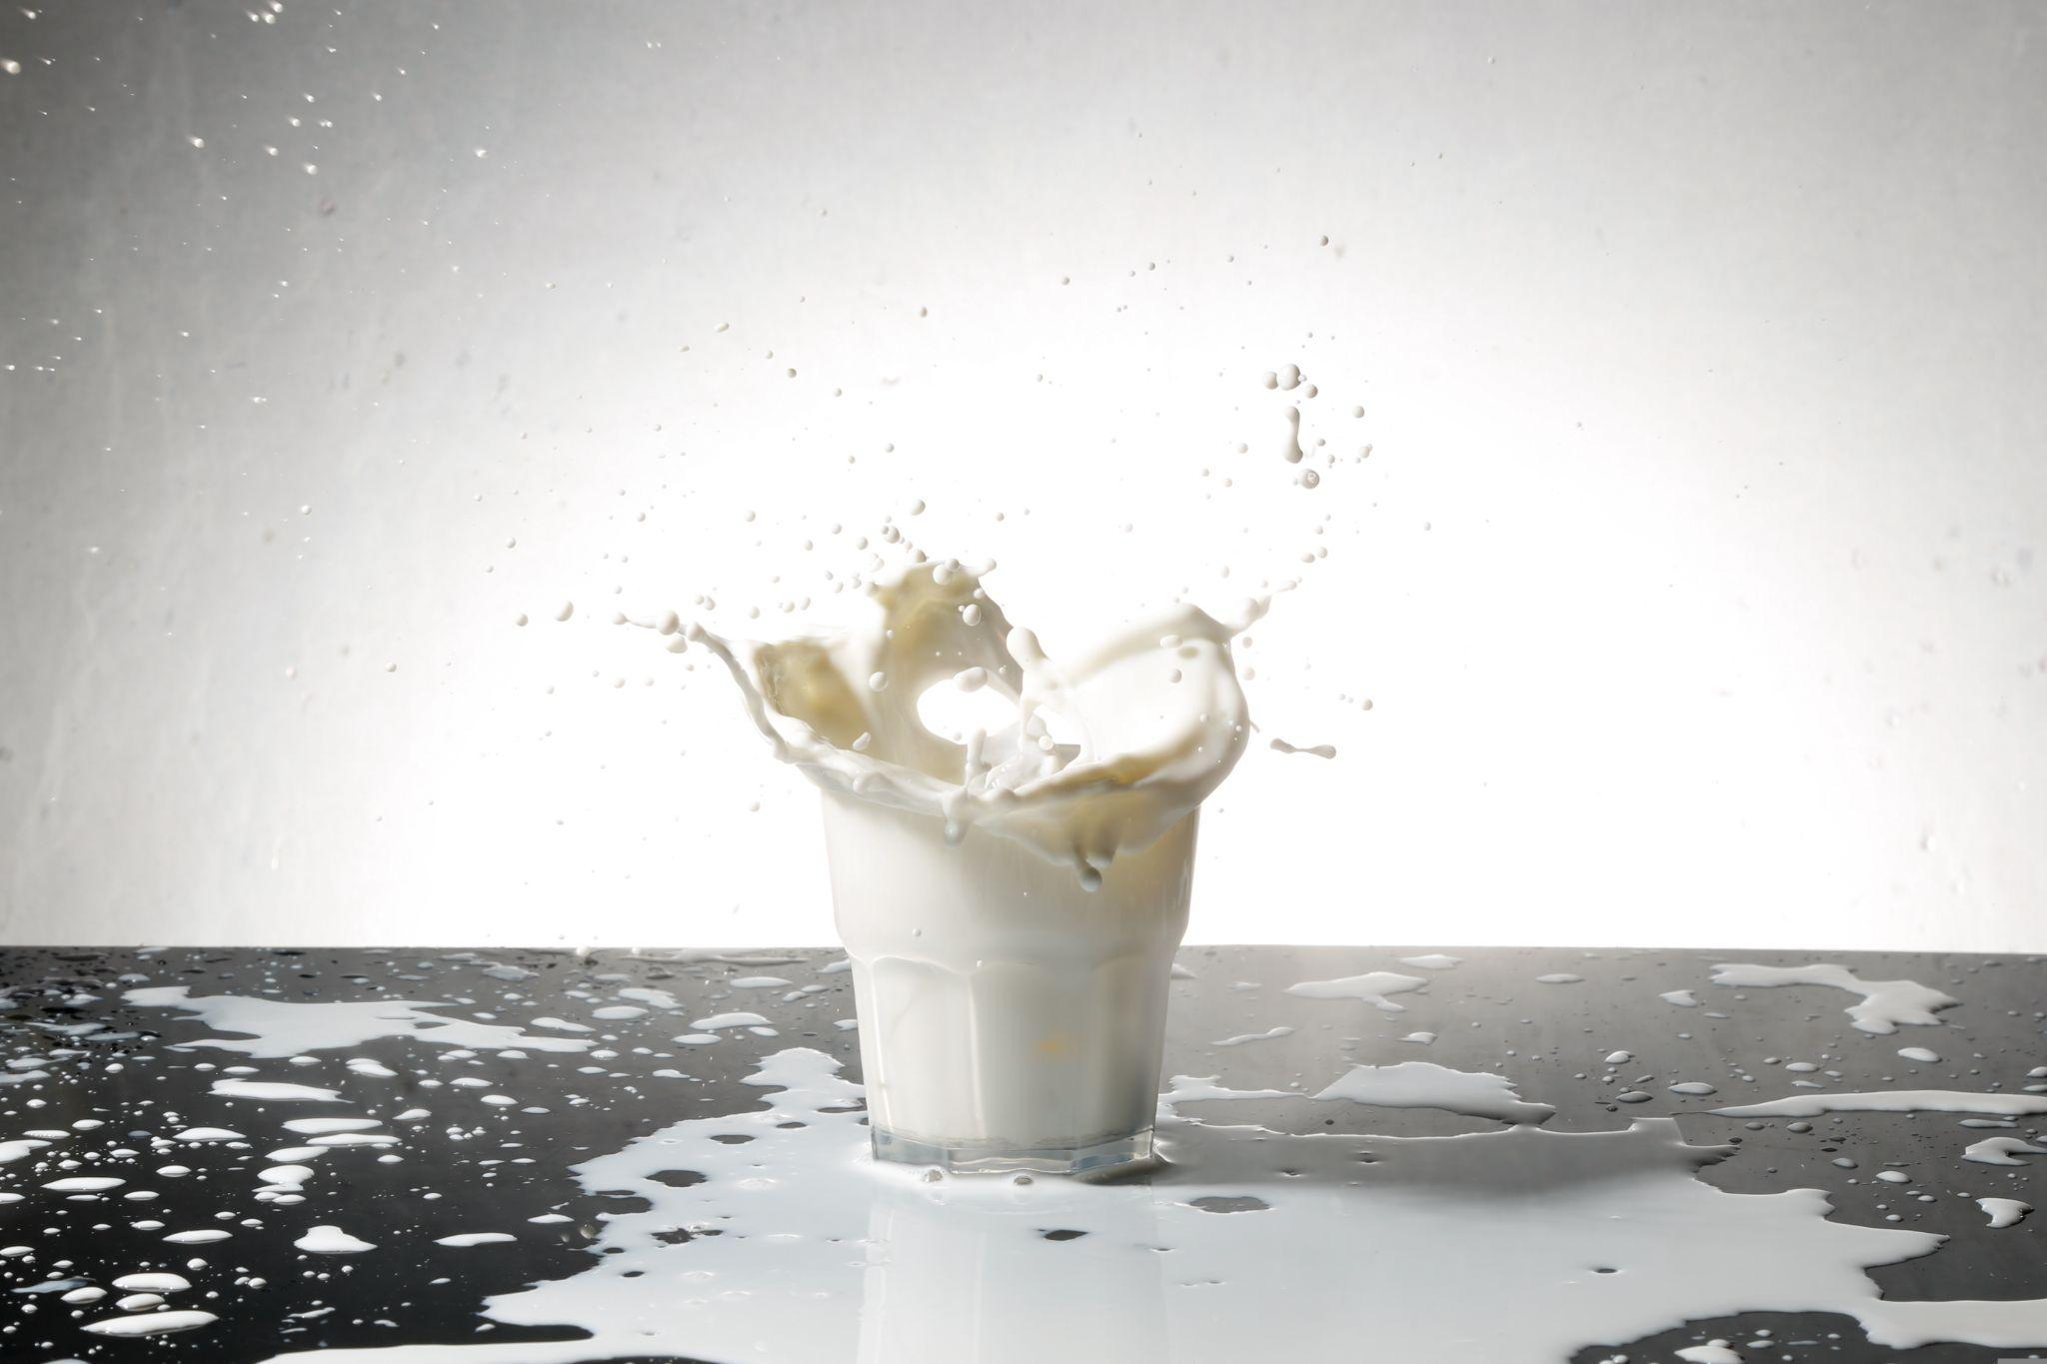
MILK QUALITY PREDICTION
BY
ABHISHEK SINGH YADAV (04)
BELO ABHIGYAN (16)
RAHUL KUMAR MANJHI (44)

Slide 2
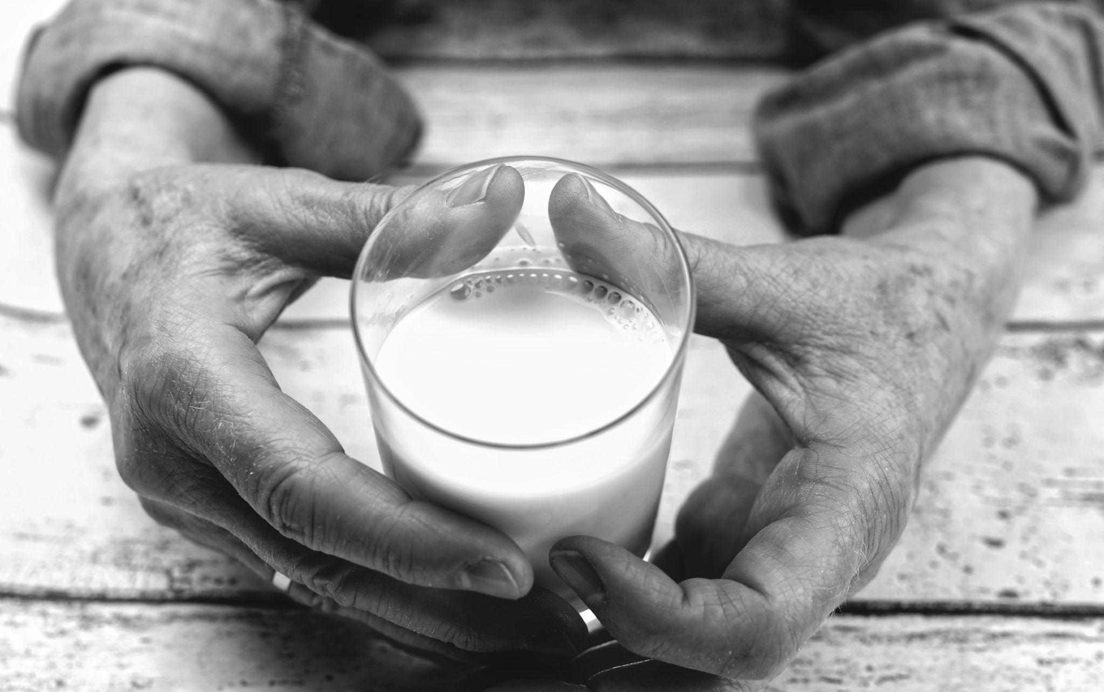
PROBLEM STATEMENT
How can we develop a machine learning model to effectively monitor milk as a perishable commodity, aiming to minimize financial losses and mitigate health risks by accurately predicting and preventing spoilage?

Slide 3
INTRODUCTION
In the digital age, machine learning (ML) algorithms are critical for data analysis and decision-making in a variety of industries. The food industry, as one of the most important sectors, stands to benefit greatly from rapid and accurate assessment of product quality. Milk being a perishable commodity that must be closely monitored to avoid financial losses and reduce the health risks associated with spoilage. This presentation formulates the assessment of milk quality using machine learning techniques.

Slide 4
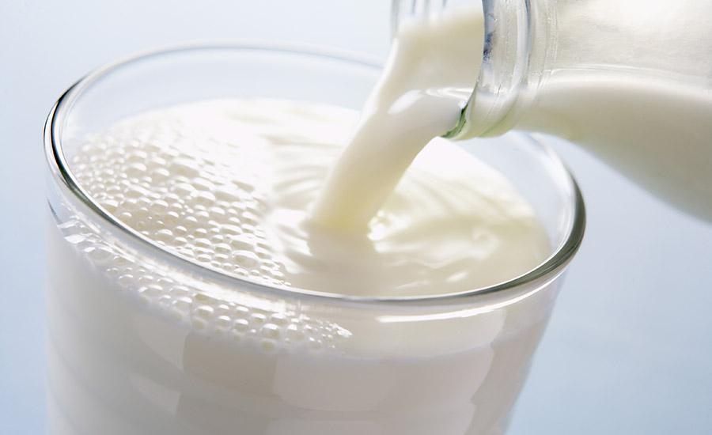
DATASET
The data set for the proposed system Collected from Kaggle repository. This dataset consists of 7 independent features. These parameters are used to predict quality of the milk. Grade (Target) of the milk which is categorical data where Low (Bad) or Medium (Moderate) and High are three different classes.The total number of records present in the dataset is 1059 rows, and 7 columns Out of all features, 4 are categorical and 3 is numeric.

Slide 5
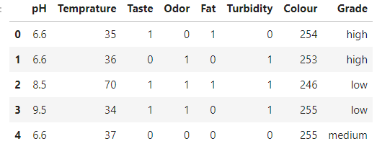
DATASET

Slide 6
DATASET FEATURES
pH: This feature defines pH of the milk, which is in the range of 3 to 9.5.
temperature: This feature defines the temperature of the milk, and its range is from 34'C to 90'C.
taste: This feature defines the taste of the milk and takes the possibles values: 1 (good) or 0 (bad).
odor: This feature defines the odor of the milk and takes the possibles values: 1 (good) or 0 (bad).
fat: This feature defines fat of the milk and takes the possibles values: 1 (good) or 0 (bad).
turbidity: This feature defines the turbidity of the milk and takes the possibles values: 1 (good) or 0 (bad).
colour: This feature defines the color of the milk, which is in the range of 240 to 255.

Slide 7
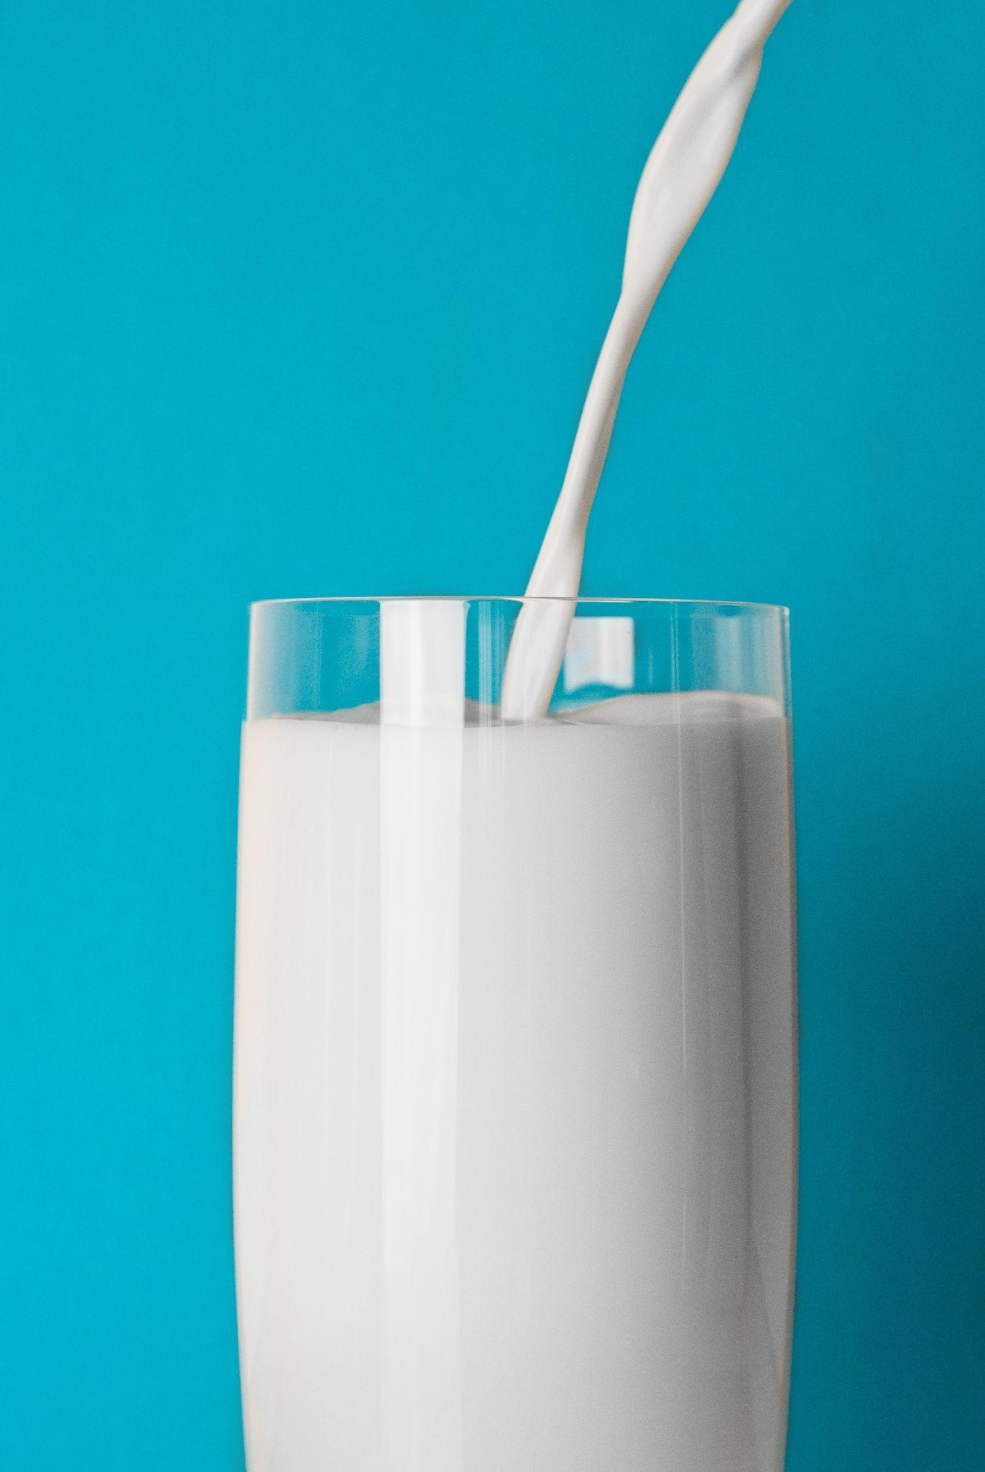
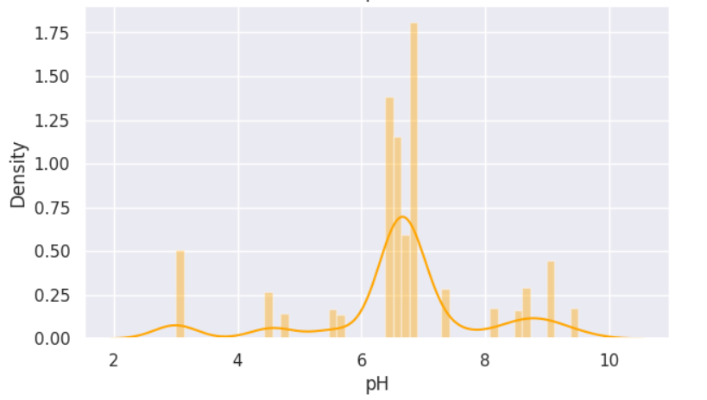
DATA ANALYSIS
All values are positive
in range(3.0: 9.5)
Majority of the values
are - 6.7

Slide 8
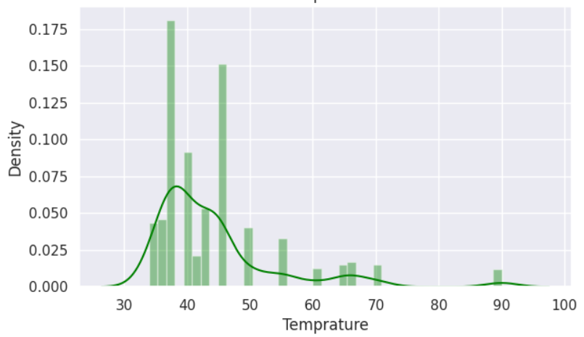
DATA ANALYSIS
All values are positive and
temperature in range
(34.0: 90.0)
Majority of degrees
- 45.0

Slide 9
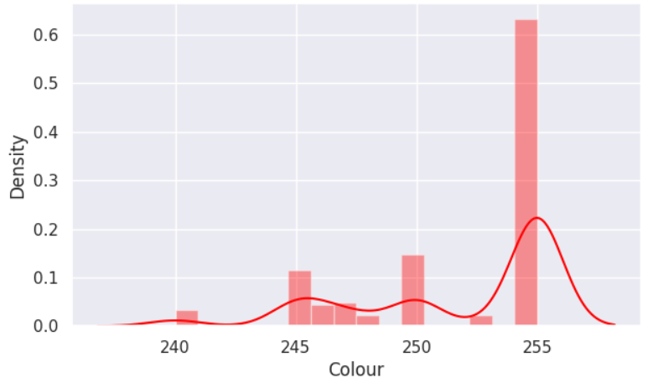
DATA ANALYSIS
All values are in range
(240.0: 255.0)
Majority values - 255.0

Slide 10
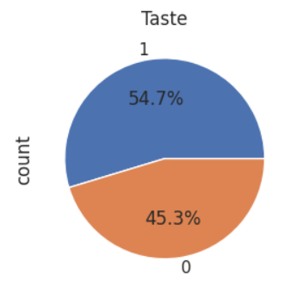
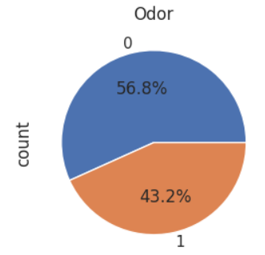
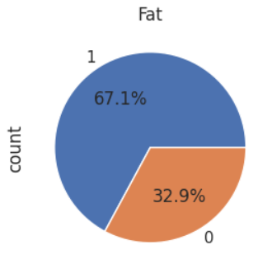
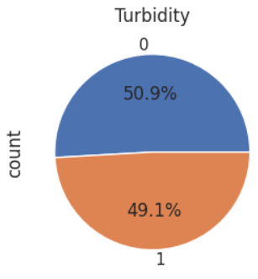
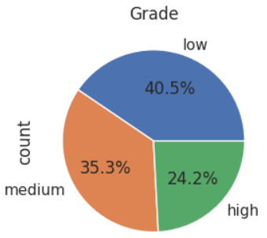
Other Categorical Features and Target

Slide 11
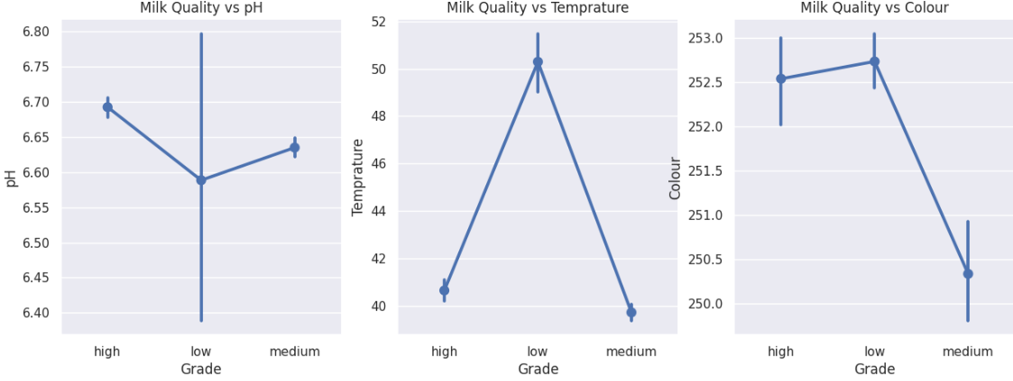
Milk quality is medium to high if pH in range (6.59: 6.67)
If temperature increases milk Quality decreases.
pH value must be kept in a certain interval at least for medium quality.
Higher temperatures could result in low quality.
Color is not a very good feature to distinguish high and low quality milk.

Slide 12
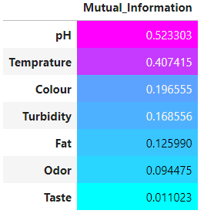
Mutual Information is used to measure the relationship between features and the target variable.
pH and Temperature will make a really good job at predictions. The others are also have significant mutual information scores.

Slide 13
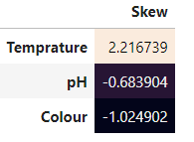
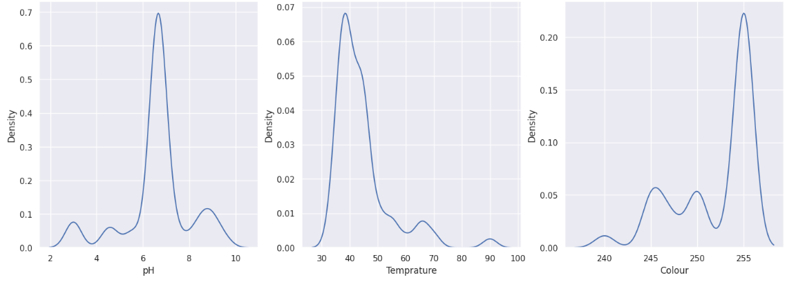
Temperature is right-skewed
Color is left-skewed.

Slide 14
Preprocessing
The first step of preprocessing involved calculating the missing value in the data. It is found that there is not a single missing value for any of the features.
Since a computer cannot comprehend the value of the attribute in the problem, label encoding is used to convert the values in this case to category integer values. This dataset's "Grade" feature employs label encoding.
The final step is to scale the feature values. This is where the Min-Max scaling or z-score scaling is used. Scaling is typically employed to improves model convergence, and prevents certain features from overshadowing others based solely on their magnitude.
Temperature is right-skewed with 2.216739 and color is left-skewed with -1.024902.
We used PowerTransformer to get rid of skewness. PowerTransformer also has standardize argument. We can set it to True to accomplish our second task: scaling.

Slide 15
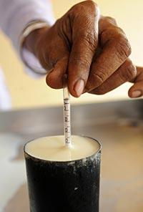
TRAIN TEST SPLIT
We have divided the dataset in 80:20 with 20% test data and 80% train data with shuffle is set to True and Stratify based on target variable.
DATASET SIZE : 1059
TRAIN SAMPLES : 847
TEST SAMPLES : 212
train_test_split(data,target,test_size=0.2,random_state=0,shuffle=True,stratify=target)

Slide 16
MODELS APPLIED
DECISION TREE
SUPPORT VECTOR MACHINE
ARTIFICIAL NEURAL NETWORK
RANDOM FOREST
GRADIENT BOOSTING CLASSIFIER
XGBOOST CLASSIFIER
ADABOOST CLASSIFIER
K-NEAREST NEIGHBOUR
USED GRIDSEARCHCV FOR MODEL TUNING.

Slide 17
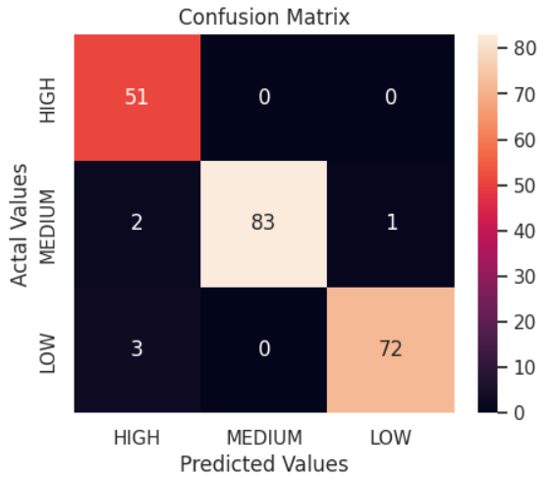
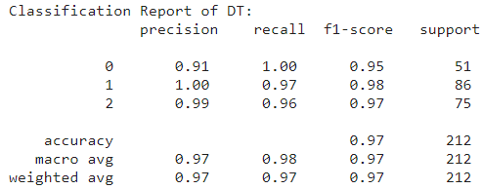
DECISION TREE
DecisionTreeClassifier('criterion': 'gini', 'max_depth': 9, random_state=1)

Slide 18
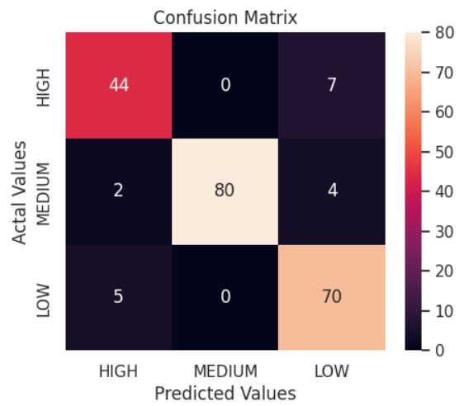
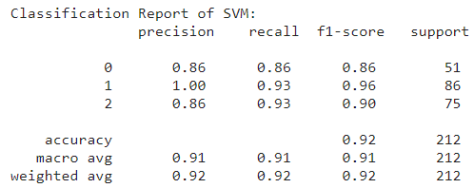
SVM
SVC(degree=4, gamma='auto', kernel='poly', probability=True, random_state=1)

Slide 19
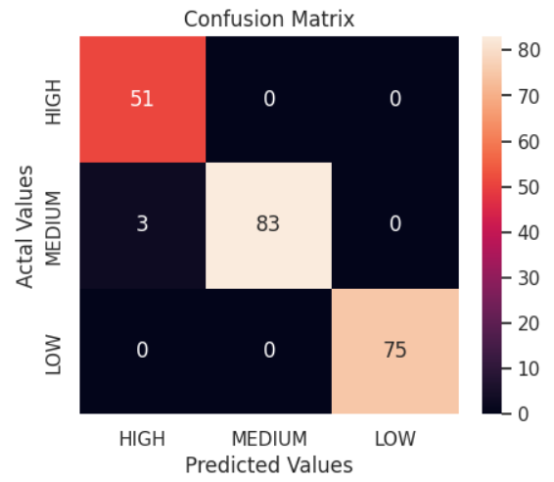
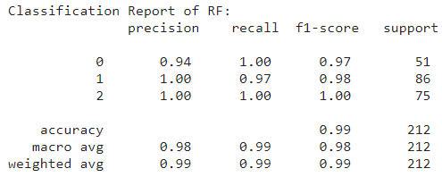
RANDOM FOREST
RandomForestClassifier('criterion': 'gini', 'max_depth': 6, 'n_estimators': 100)

Slide 20
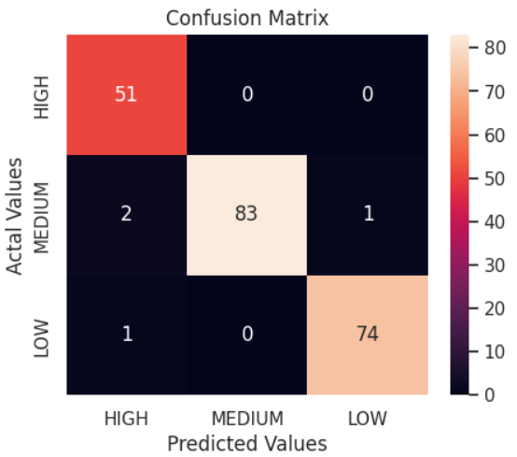
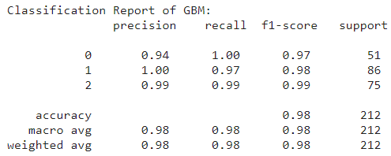
GRADIENT BOOSTING CLASSIFIER
GradientBoostingClassifier(random_state = 1)

Slide 21
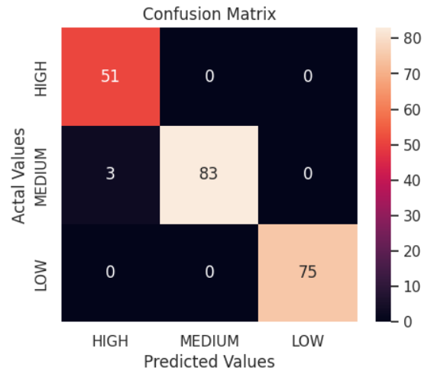
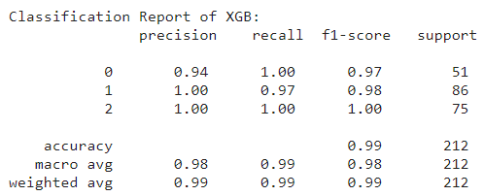
XGBOOST CLASSIFIER
XGBClassifier(random_state = 1)

Slide 22
MULTI-LAYER PERCEPTRON CLASSIFIER (ANN)
MLPClassifier(hidden_layer_sizes=(20, 15, 10), activation='relu', batch_size=10, max_iter=50,random_state=1)

Slide 23
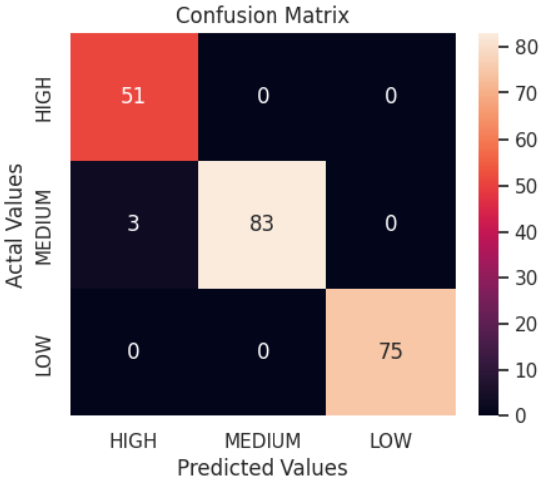
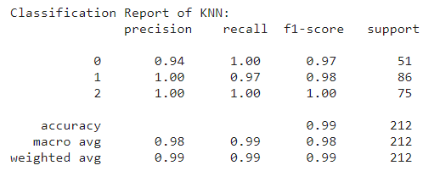
K NEAREST NEIGHBOUR
KNeighborsClassifier(n_neighbors=4)

Slide 24
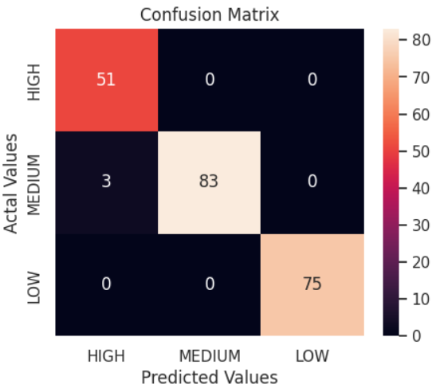
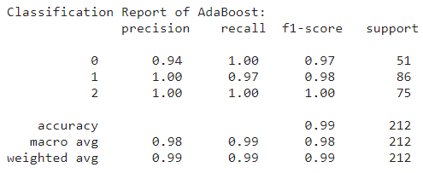
ADABOOST CLASSIFIER
ada(estimator=random_forest.best_estimator_,n_estimators=200, algorithm="SAMME.R", random_state=1)

Slide 25
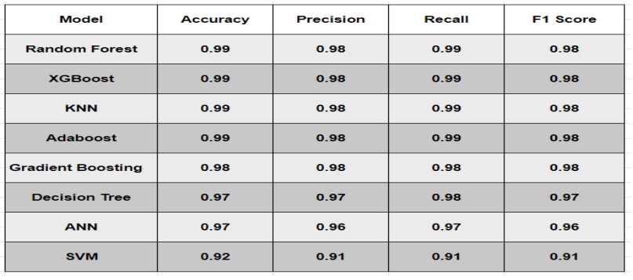
RESULT

Slide 26
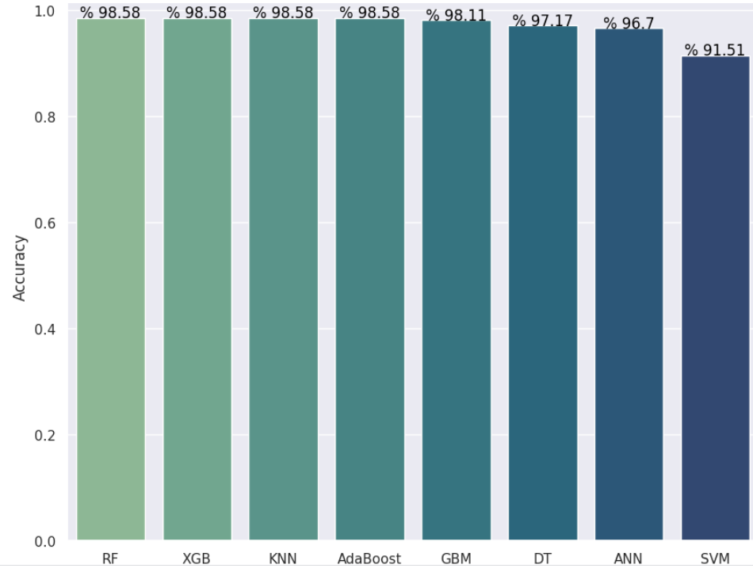

Slide 27
Conclusion
A machine learning algorithm is used to predict milk quality based on influential factors, crucial for ensuring high-quality dairy products and preventing health risks. With increasing milk consumption and global production, efficient quality control becomes challenging. Machine learning offers a time-saving and labor-efficient solution. The study uses various metric evaluations for analysis. The Random Forest, XGBoost,K Nearest Neighbour, Adaboost models performs exceptionally great in achieving improved accuracy, enhancing quality assessment processes. With AdaBoost and other mentioned models, a 98.58% success rate is achieved using 1059 samples. The study concludes that machine learning algorithms offer high accuracy in assessing dairy product quality.

Slide 28
Experimental Details
Used kaggle Notebook for all experimentation.
Python packages :
● Sklearn
● Pandas
● Numpy
● Matplotlib
● Seaborn
● Xgboost
● Warnings
NOTEBOOK LINK - https://www.kaggle.com/code/abhi3022/not ebook34395748f7

Slide 29
REFERENCE
● Milk Source Identification and Milk Quality Estimation Using an Electronic Nose and Machine Learning Techniques by Fanglin Mu , Yu Gu , Jie Zhang and Lei Zhang.
● Eurasian Journal of Food Science and Technology 2022; Vol: 6, Issue: 2, pp:76-87 76 Using Machine Learning Algorithms to Detect Milk Quality by Ahmet ÇELIK Kütahya Dumlupınar University, Tavşanlı Vocational School, Computer Technologies Department, Kütahya, Türkiye.
● EAI Endorsed Transactions on Internet of Things Research Article Milk Quality Prediction Using Machine Learning by Drashti Bhavsar , Yash Jobanputra , Nirmal Keshari Swain , Debabrata Swain.
● Proceedings of the First Australian International Conference on Industrial Engineering and Operations Management, Sydney, Australia, December 20-21, 2022 © IEOM Society International Machine Learning Applied to Milk Sample Classification by Mia León and Diego Ossa, Universidad de Lima, Carrera de Ingeniería Industrial Lima, Perú.
● International Research Journal of Modernization in Engineering Technology and Science ( Peer-Reviewed, Open Access, Fully Refereed International Journal ) Volume:05/Issue:05/May-2023 Impact Factor- 7.868 International Research Journal of Modernization in Engineering, Technology and Science

Slide 30
THANK
YOU

